Slide 1
System Hacking – Password Attack

Slide 2
Agenda
Abstract
Objective
Introduction
Methodology
Screenshots of Password Attack
Conclusion

Slide 3
The "System Hacking - Password Attack" project demonstrates key techniques in ethical hacking to assess system vulnerabilities tied to password security. By simulating real-world attack scenarios, this project uses tools like Hydra , Metasploit’s Auxiliary Modules , Nmap’s NSE Scripts , John the Ripper , and Crunch to showcase brute-force, dictionary attacks, and vulnerability scans. Each tool is utilized to highlight specific password attack methods and the associated risks of weak authentication practices. This work emphasizes the necessity of strong password policies and multi-layered security measures, offering insights into proactive cyber security strategies and the vital role of ethical hacking in identifying potential security threats.
Abstract

Slide 4
Objective
Demonstrate ethical hacking techniques to assess vulnerabilities in password-based authentication systems.
Simulate real-world password attacks using tools like Hydra, Metasploit, NSE Scripts, John the Ripper, and Crunch.
Highlight the risks associated with weak passwords and the importance of strong password policies.
Emphasize the role of ethical hacking in proactively strengthening cybersecurity defenses.

Slide 5
Introduction
In today’s digital world, password security is essential to safeguard sensitive data. As cyberattacks targeting passwords increase, ethical hacking techniques help identify and secure potential vulnerabilities before they can be exploited. The "System Hacking - Password Attack" project demonstrates password attacks, such as brute-force and dictionary attacks, using tools like Hydra, Metasploit, Nmap’s NSE, John the Ripper, and Crunch. Each tool tests different attack strategies, revealing the risks of weak passwords and emphasizing the need for strong password policies and multi-factor authentication. This project highlights ethical hacking's role in enhancing security by proactively addressing vulnerabilities.

Slide 6
Methodology
The "System Hacking - Password Attack" project methodology involves a step
by-step demonstration of various password attack techniques using ethical
hacking tools. Each tool is selected for its unique capabilities, enabling a
comprehensive approach to simulate real-world password attacks under
controlled conditions.
The methodology follows these key steps:

Slide 7
Hydra (Brute-Force Attack)
Hydra is a fast and flexible password-cracking tool often
used to perform brute-force attacks on various network protocols. It supports multiple login
protocols, making it versatile for testing security on different services like SSH, FTP, HTTP,
and more.
Objective:
To conduct brute-force attacks on network protocols (e.g., SSH, HTTP) by systematically
attempting different username-password combinations.
Process:
Set up Hydra with specified protocols, target IP, and a dictionary of potential passwords.
Execute the attack to identify any weak passwords, demonstrating the risks of weak
authentication on network services.

Slide 8
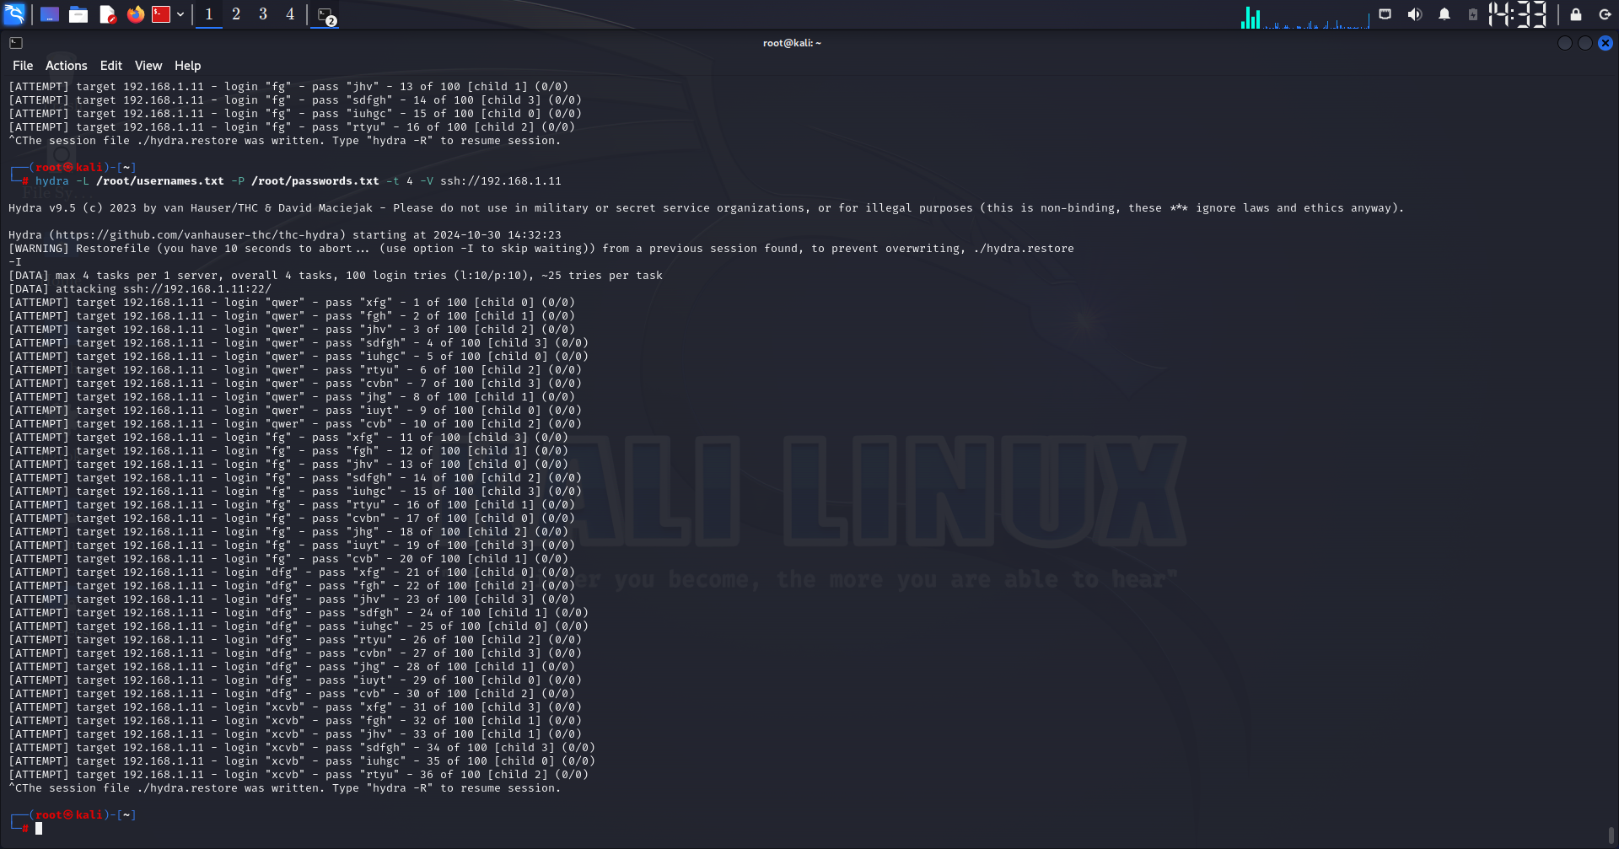
Screenshot of Hydra

Slide 9
Metasploit Auxiliary Modules (Vulnerability Scanning)
The Auxiliary Module is part of the Metasploit Framework and
includes a variety of tools for reconnaissance, scanning, and exploitation. This module helps in
identifying system vulnerabilities and gathering information, making it easier to plan password
attacks.
Objective:
To identify potential security flaws and misconfigurations in network services.
Process:
Use Metasploit’s Auxiliary Modules to scan target systems for open ports, vulnerable services, or
weak login credentials. This helps identify services susceptible to password attacks, allowing for
targeted exploitation.

Slide 10
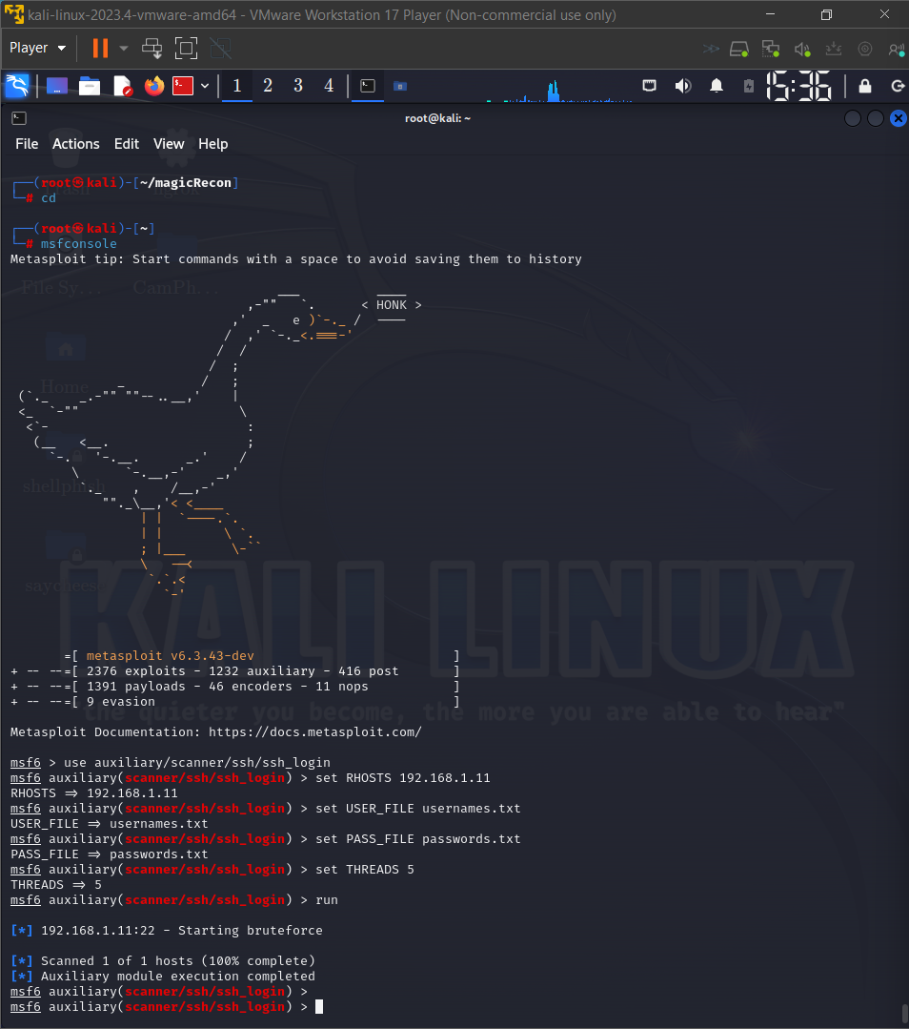
Screenshot of Auxiliary Modules

Slide 11
Nmap Scripting Engine (NSE)
NSE Scripts are customizable scripts within the Nmap tool, used
for network discovery and security auditing. Specific scripts can be leveraged for password
attacks and vulnerability detection, enhancing the capabilities of Nmap for penetration testing.
Objective:
To automate network reconnaissance and vulnerability testing.
Process:
Run NSE Scripts specific to brute-force attacks, such as http-brute or ssh-brute, to test
password strength on these services. NSE scripts allow for streamlined and automated
vulnerability scanning, saving time and effort.

Slide 12
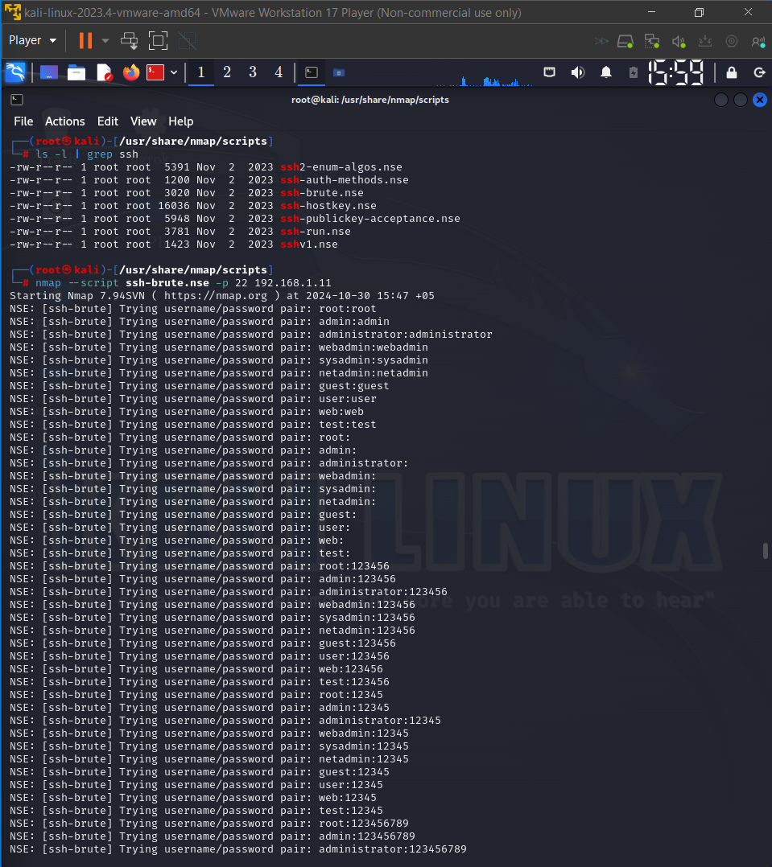
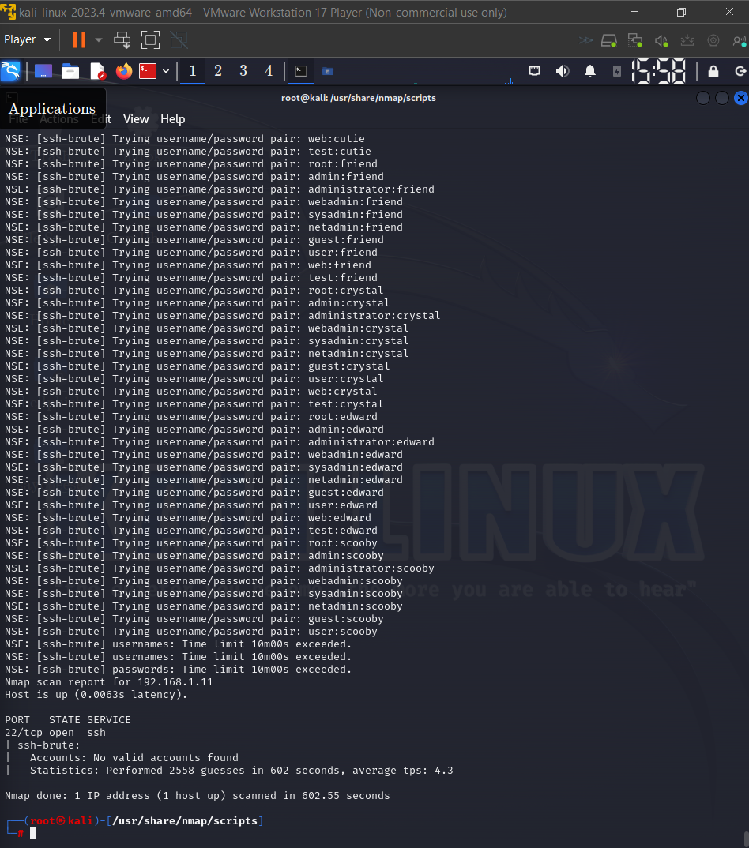
Screenshot of NSE Scripts

Slide 13
John the Ripper (Dictionary and Hybrid Attacks)
John the Ripper is a password-cracking software that
focuses on brute-force and dictionary attacks. Known for its speed, it tests various password
combinations and is highly effective against simple password schemes.
Objective:
To crack password hashes stored in local files using dictionary-based or hybrid methods.
Process:
Load a file containing hashed passwords into John the Ripper and initiate a dictionary or
hybrid attack using a wordlist. The tool systematically checks potential passwords against
the hash file, simulating a common offline password recovery method.

Slide 14
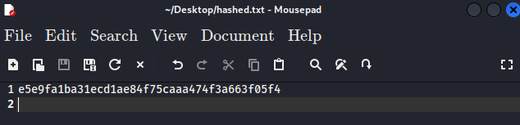
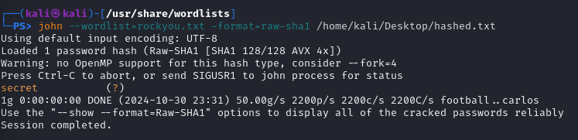
Screenshot of John the Ripper

Slide 15
Crunch (Custom Wordlist Generation)
Crunch is a wordlist generator that creates custom lists
based on specific parameters, such as length, character sets, or patterns. It is ideal for
generating dictionaries for password attacks, making it highly useful when paired with
brute-force tools like hydra.
Objective:
To generate a custom wordlist tailored to match expected password patterns.
Process:
Configure Crunch to create wordlists with specific lengths, characters, or patterns. These
lists are used in combination with Hydra or John the Ripper to optimize attacks,
demonstrating the value of targeted wordlists in speeding up password attacks.

Slide 16
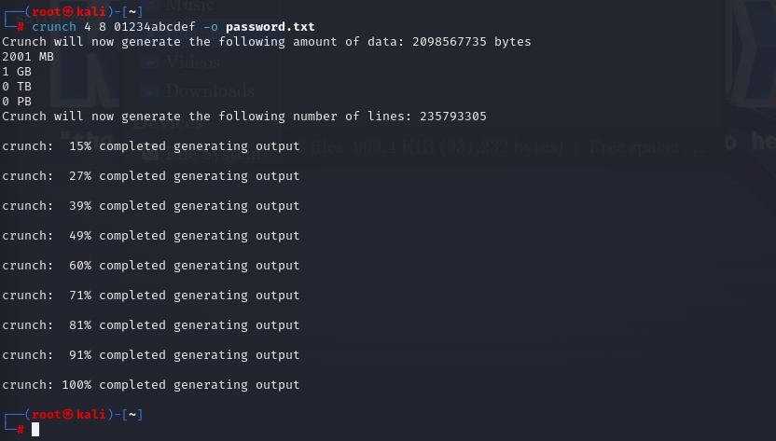
Screenshot of Crunch

Slide 17
Conclusion
This project highlights the importance of understanding password vulnerabilities through ethical hacking techniques. By using tools like Hydra, Metasploit Auxiliary Modules, Nmap’s NSE Scripts, John the Ripper, and Crunch, this project demonstrates how various password attacks can exploit weak authentication systems. Each tool’s application reveals distinct security risks associated with poor password practices, emphasizing the need for strong password policies and multi-layered authentication methods.
Through these simulations, the project reinforces the significance of proactive cybersecurity measures to detect and mitigate potential threats. Ethical hacking plays a crucial role in identifying weaknesses and improving digital defenses, ensuring that systems are better protected against unauthorized access and cyberattacks. This project underscores that, in an era of increasing cyber threats, ongoing vigilance and strong authentication practices are essential for safeguarding sensitive information and maintaining digital security.

Slide 18
Thank you

